Slide 1
Machine Learning-Clustering
.

Slide 2
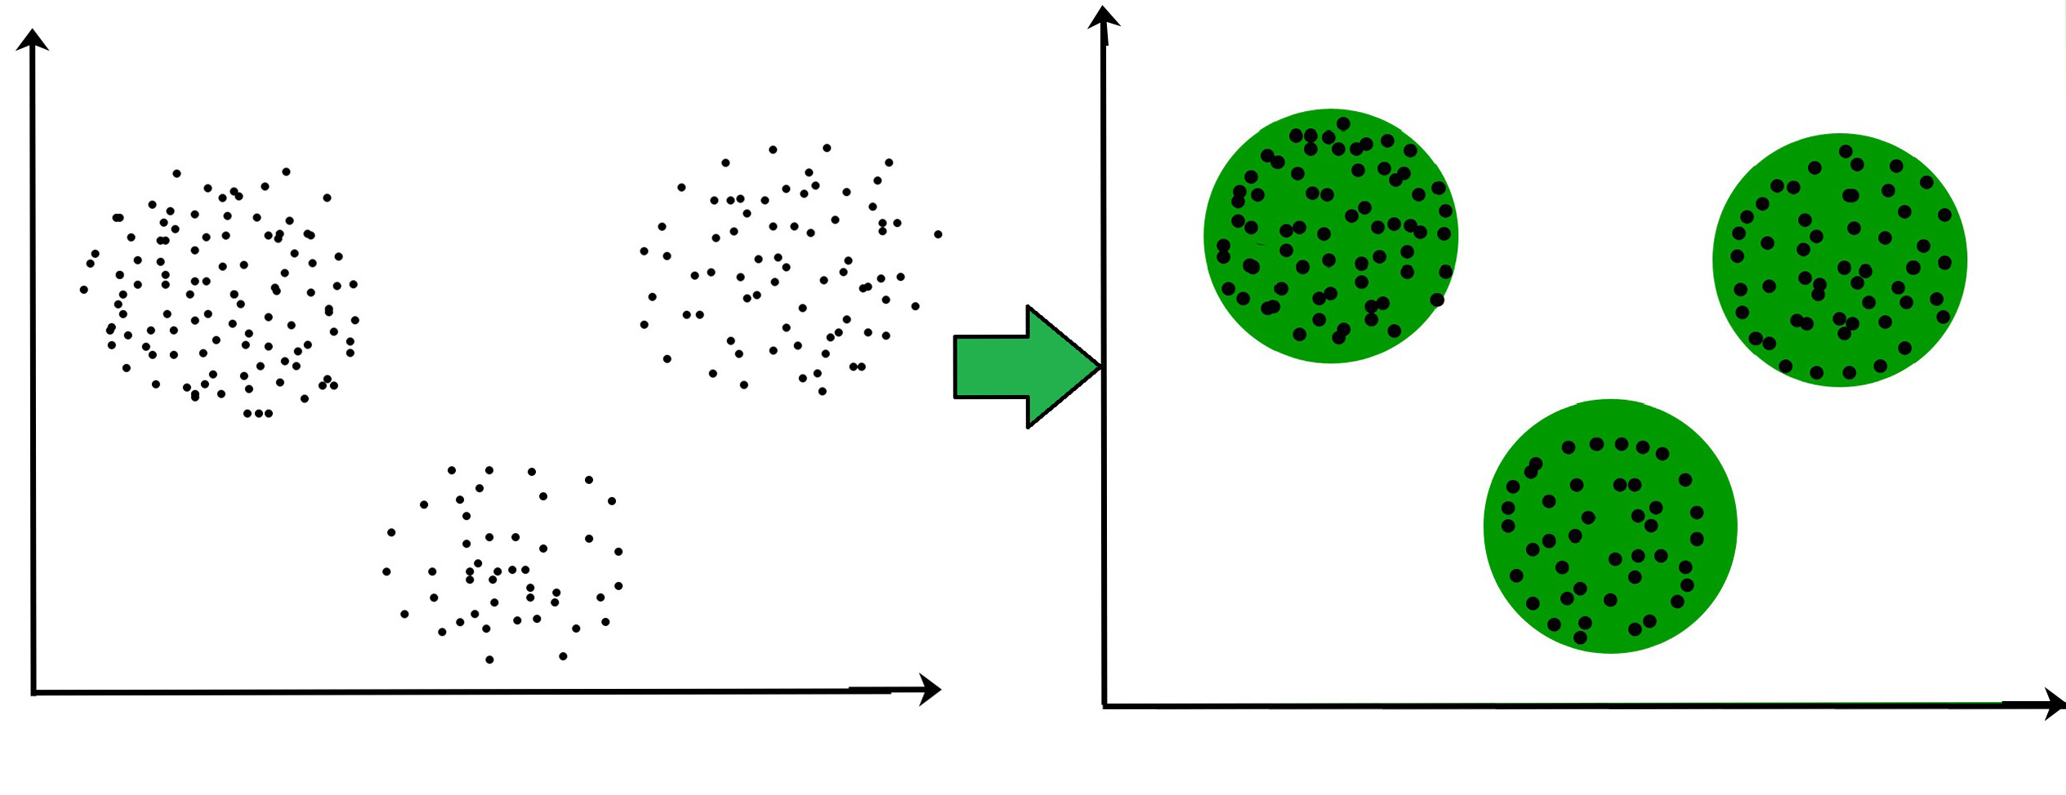
Clustering and its Types
The task of grouping data points based on their similarity with each other is called Clustering or Cluster Analysis. This method is defined under the branch of unsupervised learning ,which aims at gaining insights from unlabelled data points, that is, unlike Supervised learning.we don’t have a target variable.
Clustering aims at forming groups of homogeneous data points from a heterogeneous dataset. It evaluates the similarity based on a metric like Euclidean distance, Cosine similarity, Manhattan distance, etc. and then group the points with highest similarity score together.
For Example, In the graph given below, we can clearly see that there are 3 circular clusters forming on the basis of distance.

Slide 3
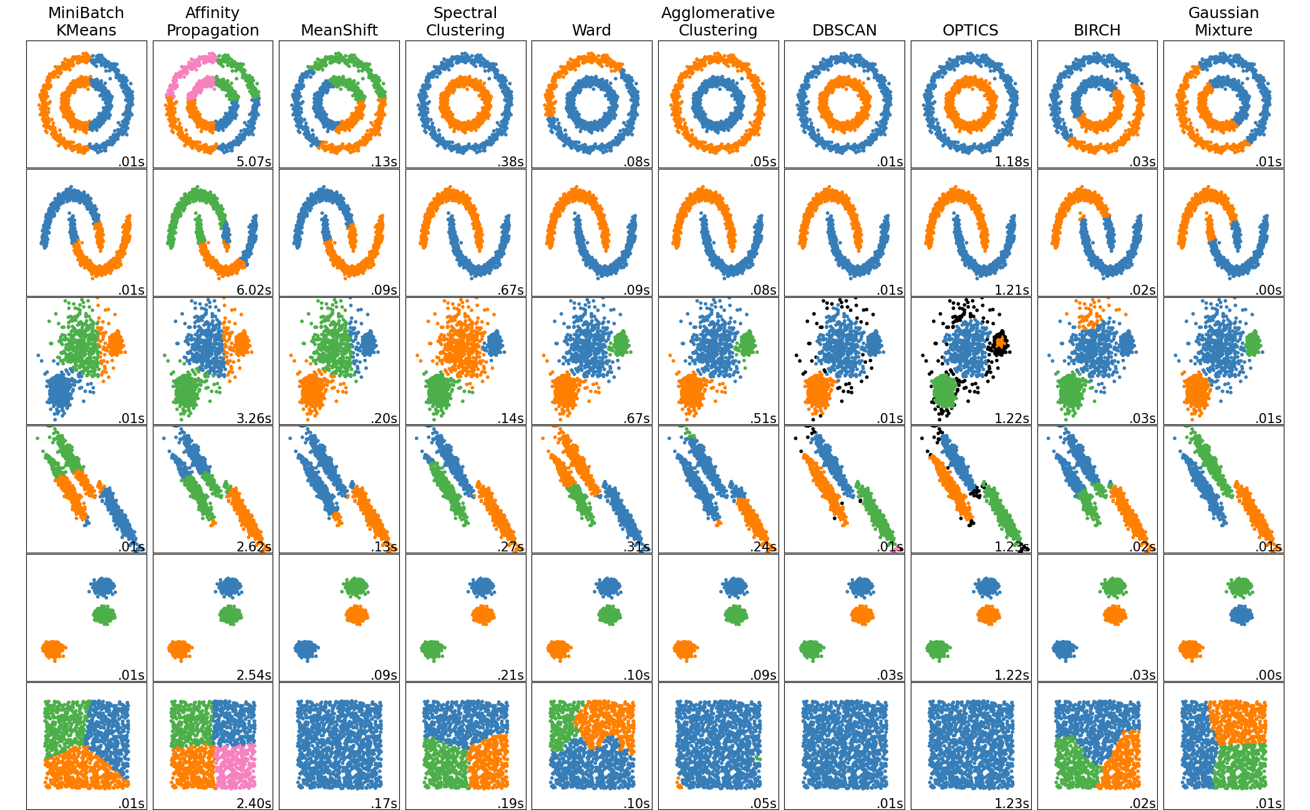
Types of clustering
K-means clustering
Hierarchial clustering
Affinity propagation clustering
Mean-shift clustering
Spectral clustering
Birch clustering
DBSCAN clustering
Bisecting Kmeans clustering
OPTICS clustering

Slide 4
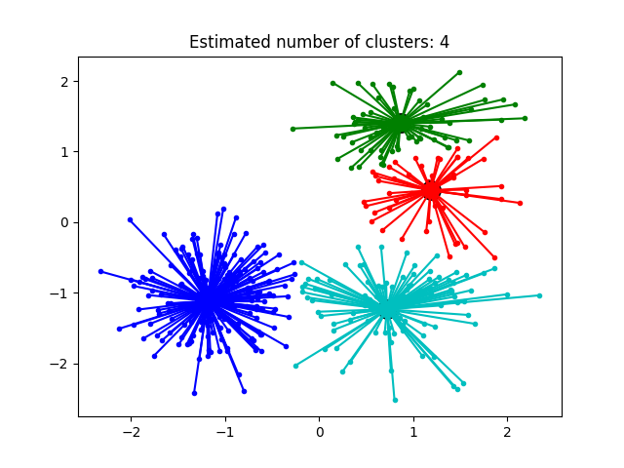
AFFINITY PROPAGATION CLUSTERING
Affinity Propagation creates clusters by sending
messages between pairs of samples until
convergence.
A dataset is then described using a small number of
exemplars, which are identified as those most
representative of other samples.
Affinity Propagation works based on similarities
between data points
Identifies a set of cluster center that represents
the dataset

Slide 5
Advantage and Disadvantage
Advantages:-
Has better performance and lower clustering error
Disadvantages:-
It is quite slow and memory-heavy, making it difficult to scale to larger datasets. We do not have any direct control on the number of clusters but in some applications, we need a specific number of clusters.
It also assumes the true underlying clusters are globular

Slide 6
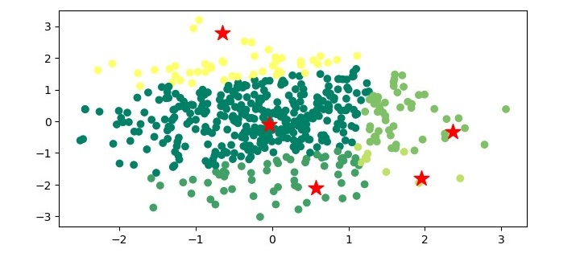
Mean-Shift clustering
Mean-shift algorithm basically assigns the datapointsto the clusters iteratively by shifting points towards the highest density of datapoints i.e. cluster centroid.
The difference between K-Means algorithm and Mean-Shift is that later one does not need to specify the number of clusters in advance because the number of clusters will be determined by the algorithm
The steps involved in the Mean-Shift clustering algorithm are as follows −
Initialize the mean of each data point to its own value.
For each data point, compute the mean shift vector, which is the tor that points towards the densest area of the data.
Update the mean of each data point by shifting it towards the densest area of the data.
Repeat steps 2 and 3 until convergence is reached.

Slide 7
Advantage and Disadvantage
Advantages:-
It does not need to make any model assumption as like in K-means or Gaussian mixture.
It can also model the complex clusters which have nonconvex shape.
It only needs one parameter named bandwidth which automatically determines the number of clusters.
There is no issue of local minima as like in K-means.
No problem generated from outliers.
Disadvantages:-
Mean-shift algorithm does not work well in case of high dimension, where number of clusters changes abruptly.
We do not have any direct control on the number of clusters but in some applications, we need a specific number of clusters.
It cannot differentiate between meaningful and meaningless modes.

Slide 8
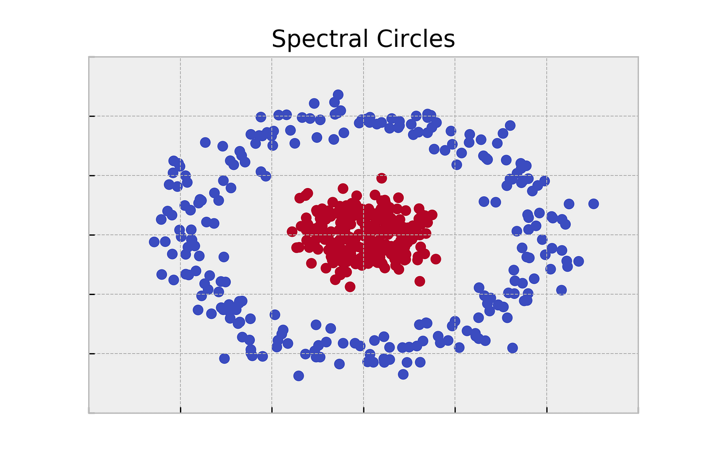
SPECTRAL CLUSTERING
In spectral clustering, data points are treated as nodes of a graph. Thus, spectral clustering is a graph partitioning problem.
The nodes are then mapped to a low-dimensional space that can be easily segregated to form clusters. No assumption is made about the shape/form of the clusters.
The goal of spectral clustering is to cluster data that is connected but not necessarily compact or clustered within convex boundaries.
Spectral co-clustering is a type of clustering algorithm that is used to find clusters in both rows and columns of a data matrix simultaneously. This is different from traditional clustering algorithm, which only cluster the rows or columns of a data matrix.

Slide 9
Advantage and Disadvantage
Advantages:-
Applicable for high dimensional datasets. One of the main advantages that spectral clustering has over other clustering algorithms is that it can be used on high-dimensional datasets with many features.
Not strong assumptions about cluster shape. Spectral clustering does not make strong assumptions about the shape of the clusters in the data. That means that it is appropriate to use spectral clustering even when you suspect the clusters in your data may be irregularly shaped.
Can sometimes handle categorical variables. Some implementations of spectral clustering can handle cases where you have mixed data types, such as cases where you have categorical variables in your data. This is in part because spectral clustering uses similarity metrics rather than distance metrics to determine which points have more in common.
Disadvantages:-
Relatively slow. One disadvantage of spectral clustering is that it is relatively slow compared to other clustering algorithms like k-means clustering.
If you have a dataset with many, many data points then you may be better off using a faster algorithm.
Need to select the number of clusters. As with many other clustering algorithms, spectral clustering requires you to select the number of clusters that should be used for your dataset. This can be difficult to do if you do not have strong intuition about the true number of clusters in the data.

Slide 10
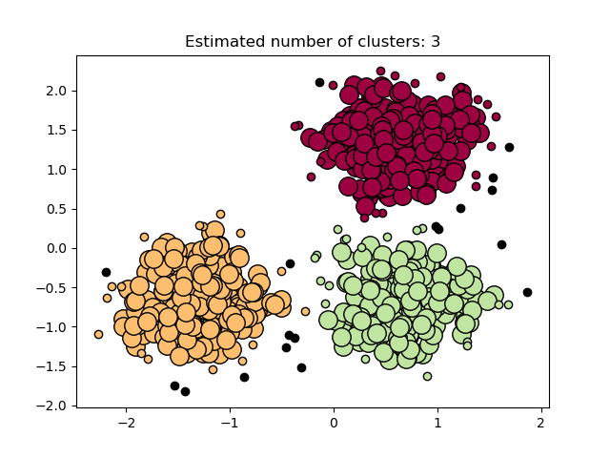
DBSCAN CLUSTERING
Density-Based Spatial Clustering of Applications with Noise - (DBSCAN) clustering.
DBSCAN is a density-based clustering algorithm that works on the assumption that clusters are dense regions in space separated by regions of lower density. It groups 'densely grouped' data points into a single cluster.
Any core sample is part of a cluster, by definition. Any sample that is not a core sample, and is at least eps in distance from any core sample, is considered an outlier by the algorithm.
In the figure below, the color indicates cluster membership, with large circles indicating core samples found by the algorithm. Smaller circles are non-core samples that are still part of a cluster. Moreover, the outliers are indicated by black points below.

Slide 11
Advantage and Disadvantage
Advantages:-
DBSCAN is great at separating high-density clusters from low-density clusters,
DBSCAN can be used to detect clusters that are oddly or irregularly shaped, such as clusters that are ring-
shaped.
DBSCAN is used to handle clusters of multiple sizes and structures and is not powerfully influenced by
noise or outliers.
Disadvantages:-
DBSCAN struggles with clusters of similar density.
Struggles with high dimensionality data. If given data with too many dimensions, DBSCAN suffers.

Slide 12
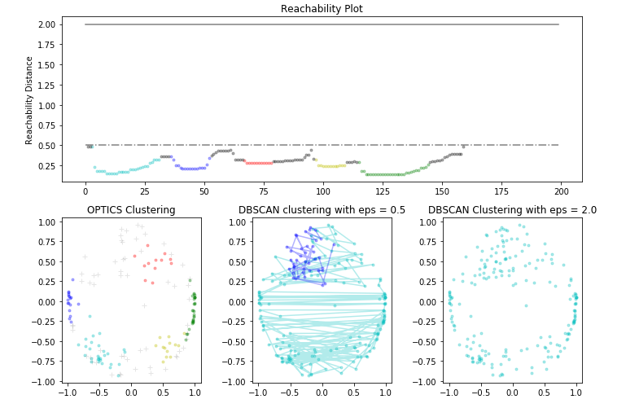
OPTICS CLUSTERING
Ordering Points To Identify Cluster Structure - (OPTICS)
OPTICS is a density-based clustering algorithm, similar to DBSCAN, but it can extract clusters of varying densities and shapes.
The main idea behind OPTICS is to extract the clustering structure of a dataset by identifying the density-connected points.
The algorithm builds a density-based representation of the data by creating an ordered list of points called the reachability plot. Each point in the list is associated with a reachability distance, which is a measure of how easy it is to reach that point from other points in the dataset. Points with similar reachability distances are likely to be in the same cluster.
Note that for any single value of eps, DBSCAN will tend to have a shorter run time than OPTICS; however, for repeated runs at varying eps values, a single run of OPTICS may require less cumulative runtime than DBSCAN. It is also important to note that OPTICS’ output is close to DBSCAN’s only if eps and max_eps are close.

Slide 13
Advantage and Disadvantage
Advantages
OPTICS clustering doesn't require a predefined number of clusters in advance
Clusters can be of any shape, including non-spherical ones
Disadvantages
It fails if there are no density drops between clusters
It is also sensitive to parameters that define density (radius and the minimum number of points) and proper parameter settings require domain knowledge.

Slide 14
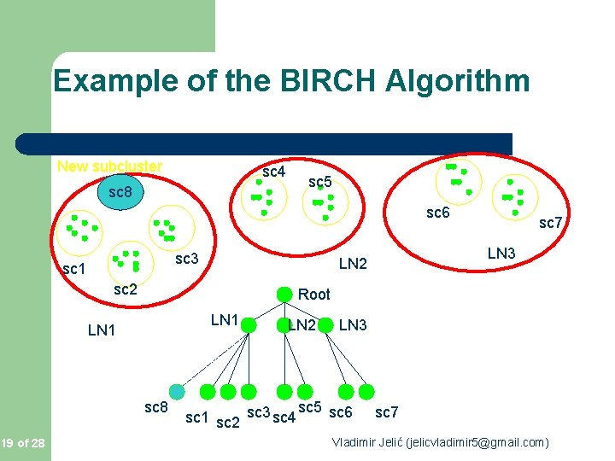
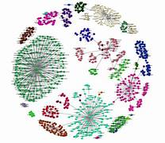
BIRCH CLUSTERING
Balanced Iterative Reducing and Clustering using Hierarchies - (BIRCH)
Clustering algorithms like K-means clustering do not perform clustering very efficiently and it is difficult to process large datasets with a limited amount of resources. So, regular clustering algorithms do not scale well in terms of running time and quality as the size of the dataset increases.This is where BIRCH clustering comes in.
BIRCH clustering algorithm can cluster large datasets by first generating a small and compact summary of the large dataset that retains as much information as possible. This smaller summary is then clustered instead of clustering the larger dataset.
The BIRCH algorithm has two parameters, the threshold and the branching factor. The branching factor limits the number of subclusters in a node and the threshold limits the distance between the entering sample and the existing subclusters.

Slide 15
Advantage and Disadvantage
Advantages
BIRCH is useful for performing precise Clustering on large datasets
An main advantage of BIRCH is its ability to incrementally and dynamically cluster incoming, multi-
dimensional metric data points to produce the best quality clustering for a given set of resources (memory and time constraints). In most cases, BIRCH only requires a single scan of the database.
Disadvantages
BIRCH has one major drawback, it can only process metric attributes. A metric attribute is an attribute whose values can be represented in Euclidean space, i.e., no categorical attributes should be present.

